Slide 1
Software Craftsmanship
Cédric HARTLAND

Slide 2
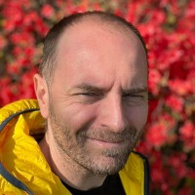
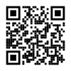
About
Cédric HARTLAND
Ph.D. in AI – UPSud, INRIA, CNRS
Courses in AI & CS since 20
2005 – 2010 – Researcher / Lecturer
2010 – 2017 – CAST
2017-2019 – Futurmaster
2019-2022 – Talentsoft
2022 – PlayPlay
2022+ - Thales Digital Factory

Slide 3
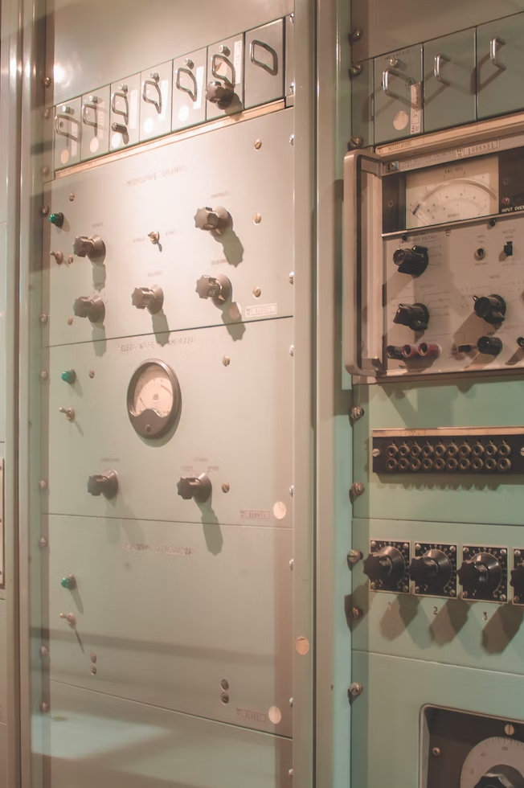


Software crisis, engineering & crafts

Slide 4
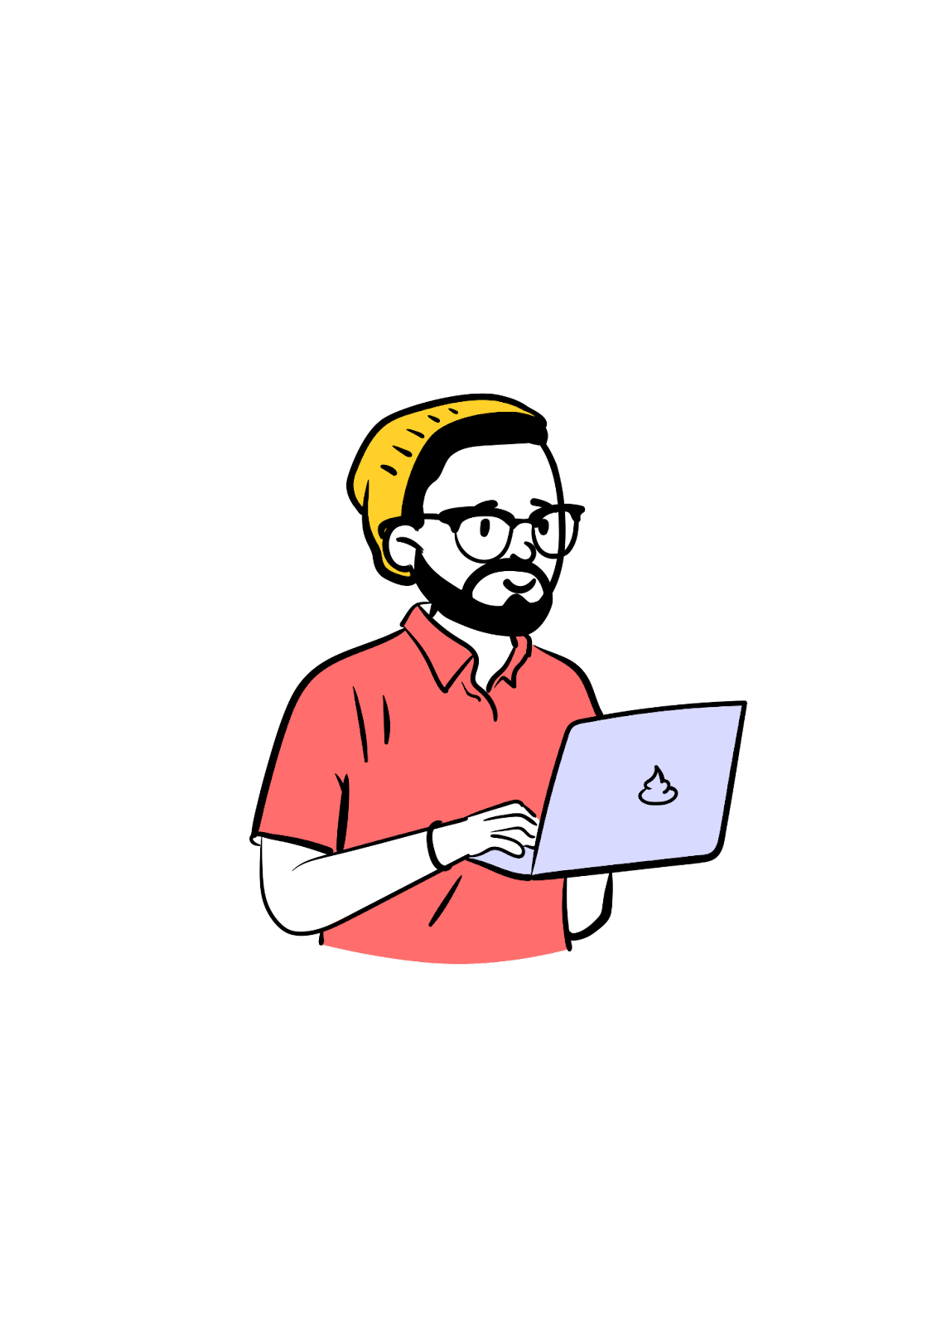
Developer ↮ Code
culture
Peer/mob
KISS
agile
CI/CD
SLA
DRY
methodology
hosting
monitoring
Best
practices
collaboration
UI
Clean
code
Happy Customer
DX
lean
User
driven
security
TDD
learning
Happy Users
Auto tests
UX
Database
SOLID
Programming language
professionalism
OOP
Design patterns
architecture

Slide 5
The multiverse of acronyms
KISS Keep It Simple Stupid
DRY Don’t Repeat Yourself
YAGNI You Ain’t Gonna Need It
DIE Duplication Is Evil
OOP Object Oriented Principles
SOLID
SRP Single Responsibility Principle
OCP Open/Closed Principle
LSP Liskov Substitution Principle
ISP Interface Segregation Principle
DIP Dependency Inversion Principle

Slide 6
Manifesto for Software Craftsmanship
Raising the bar.
As aspiring Software Craftsmen we are raising the bar of professional software development by practicing it and helping others learn the craft. Through this work we have come to value
Not only working software, but also well-crafted software
Not only responding to change but also steadily adding value
Not only individuals and interactions, but also a community of professionals
Not only customer collaboration, but also productive partnerships
That is, in pursuit of the items on the left we have found the items on the right to be indispensable.
Notes:
http://manifesto.softwarecraftsmanship.org/#/en

Slide 7

Well-crafted software
Not only working software, but also well-crafted software Well-crafted == high quality code
Automated tests
Business language in the code
Appropriate design
Code quality is not guarantee of success
but can be the main cause of failure

Slide 8

Steadily adding value
Not only responding to change, but also steadily adding value constantly improve your code
Testable
Extendable
Refactoring
Boy scout rule always leave the campground cleaner than you found it

Slide 9

Community of professionals
Not only individuals and interactions, but also a community of professionals share / mentor
Knowledge
Ideas
Successes & failures
Craftsman want to work with passionate and inspiring professionals

Slide 10

Productive partnerships
Not only customer collaboration, but also productive partnerships we are not factory workers
Must help our clients / users
Must be able to say no for clients goods
Some clients are not ready harder to manage

Slide 11
Developer eXperience
Challenges
Technical
Bugs
Technical debt
Coding practices
Working with others
Conflict management
Opinions
Teamwork
Customer pressure
« for yesterday »
« Not working »
Low quality
Have an
IMPACT
Technical
achievements
Infinite source
for learning

Slide 12
Course focus
Code
Clean code
Test & refactoring
Best practices
Ways of working
Agility
Collective programming practices
Contexts
Embedded, desktop, on premise, cloud

Slide 13
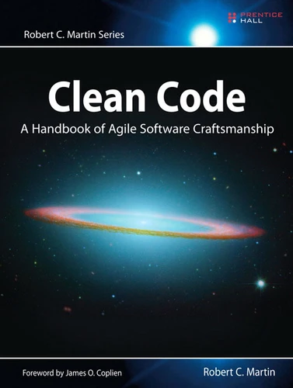
Clean Code fundamentals
https://gist.github.com/cedrickchee/55ecfbaac643bf0c24da6874bf4feb08
Notes:
https://gist.github.com/cedrickchee/55ecfbaac643bf0c24da6874bf4feb08

Slide 14
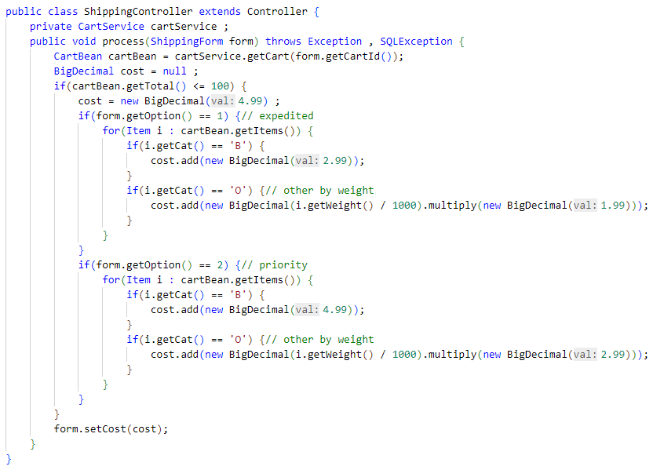
1 ↔ expedited ??
Magic Numbers ??
Copy paste (?)
B, O ??
Unit ?
Currency ?

Slide 15
Clean code
Set of « best » practices or antipatterns avoidance
Technical design
Understandability
Naming
Function
Comments
Coding
Object oriented
Testing
Error handling
…

Slide 16
General Rules
Follow standard conventions
Work together
KISS
Simpler is always better – reduce complexity
Boy scout rule
Leave the place cleaner than you found it
Always find root cause
A problem’s cause is not always the one you see first
Follow the principle of least surprise
System should behave the way we expect them to – users are part of the system
DRY
Don’t repeat yourself
Do not override safeties
They exist for a reason

Slide 17
Design rules
Keep configurable data at high level
They should be easy to change
Prefer polymorphism
to if/else or switch/case
Separate multi-threading code
Prevent over-configurability
Use dependency injection
Follow law of demeter

Slide 18
Understandability
Be consistent
Whatever the way, stick with it
Use explanatory variables
Encapsulate boundary conditions
Prefer dedicated value objects
to primitive type
Avoid logical dependency
Prefer purity
Avoid negative conditionals

Slide 19
Names rules
Choose descriptive and unambiguous names
Make meaningful distinction
Use pronounceable names
Use searchable names
Replace magic numbers with named constants
Avoid encodings
Don’t append prefixes or type information

Slide 20
Functions rule
Keep them small
Do one thing
And do it well
Use descriptive names
Prefer fewer arguments
≤ 3 arguments
Have no side effects
Don’t use flag arguments
Split method into several independent methods

Slide 21
Comment rules
Always try to explain with code
Not with comments
Don’t be redundant
i++; // increment i 😫
Don’t add obvious noise
Don’t use closing brace comments
E.g. // end of function
Don’t comment out code
Just remove it
Use as explanation of intent
Use as clarification of code
Use as warning of consequence

Slide 22
Source code structure
Separate concepts vertically
Related code should appear vertically dense
Declare variables close to their usage
Dependent functions should be close
Similar functions should be close
Place functions in the downward direction
Keep lines short
Don’t huse horizontal alignment
Use white space to associate related thing and disassociate weakly related
Don’t break indentation

Slide 23
Objects and data structures
Hide internal structure
Prefer data structure
Avoid hybrids structures
Should be small
Do one thing
Small number of instance variables
Base class should know nothing of their derivatives
Better to have many functions than to pass some code into function to select a behavior
Prefer non-static methods to static methods

Slide 24
Tests
One assert per test
Fast
Independent
Repeatable
self-validating
Timely
Readable
Easy to run
Use a coverage tool

Slide 25
TDD
Write test and code together
You may not write production code until you have written a failing unit test
You may not write more of a unit test than is sufficient to fail (including compilation errors)
You may not write production code that is sufficient to pass the currently failing test

Slide 26
Code smells
Rigidity
Software difficult to change; a small change causes a cascade of subsequent changes
Fragility
The software breaks in many places due to a single change
Immobility
You cannot reuse part of the code in other projects becose of involved risks and high effort
Needless complexity
Needless repetition
Opacity
The code is hard to understand

Slide 27
Error handling
Don’t mix error handling and code
Use exceptions instead of returning error codes
Don’t return null
Don’t pass null either
Throw exceptions with context

Slide 28
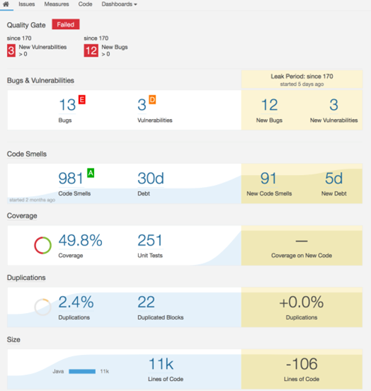
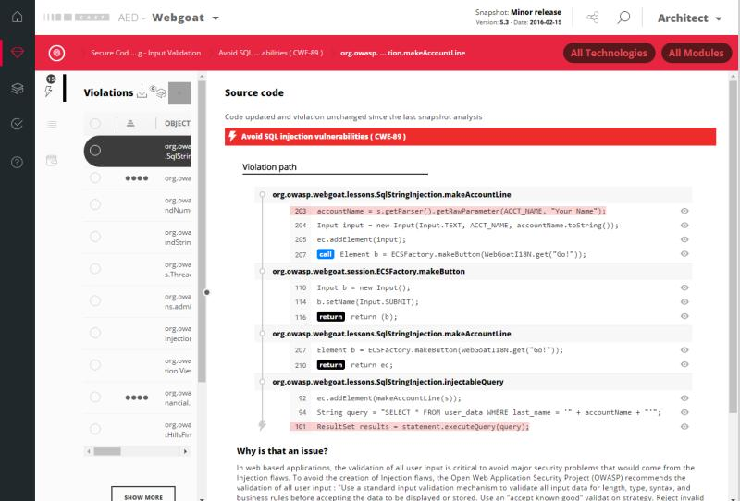
Technical debt
Everything that breaks your productivity
wrong technical designs, little tests, code readability, bugs, crappy doc, process mess, fuzzy requirements, high lead time, …

Slide 29
Pictures comes from unsplash.com
Avatars from open peeps flat assets
Manifesto for software craftsmanship http://manifesto.softwarecraftsmanship.org/#/en
https://github.com/fmbenhassine/awesome-software-craftsmanship

